Slide 1
Unit 4: For Live Session Assignment
Alternatives to the t-tools!

Slide 2
Part 1

Slide 3
Quick Quiz Questions

Slide 4
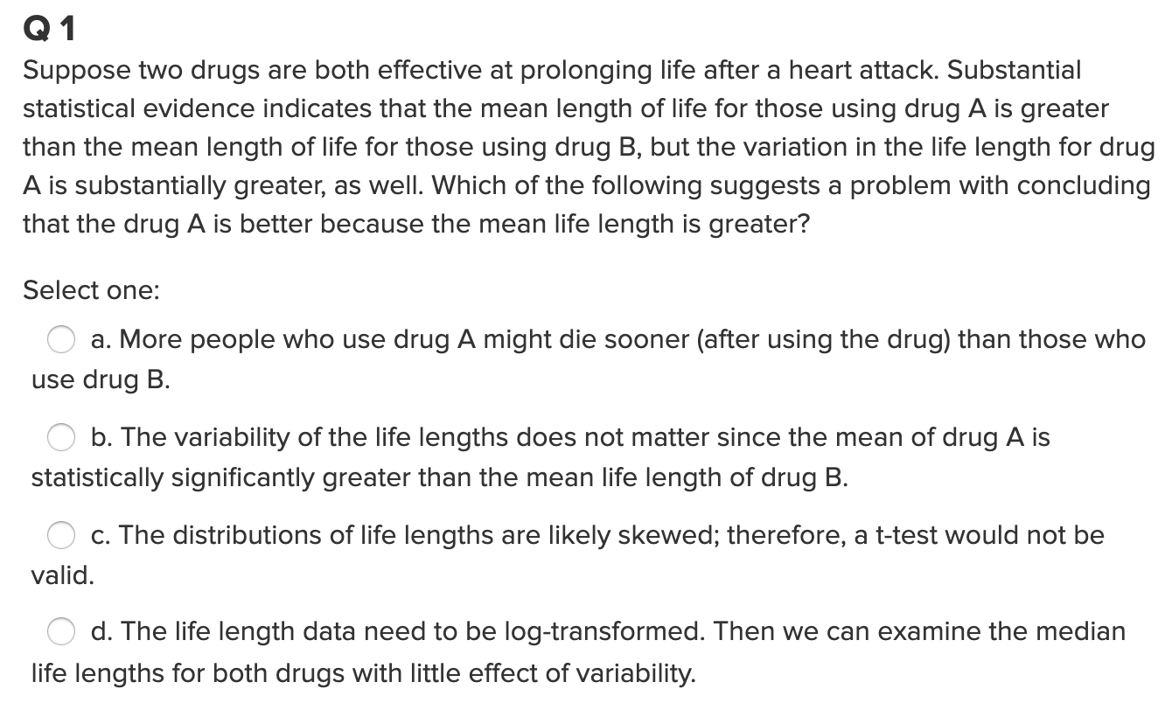
Question 1

Slide 5
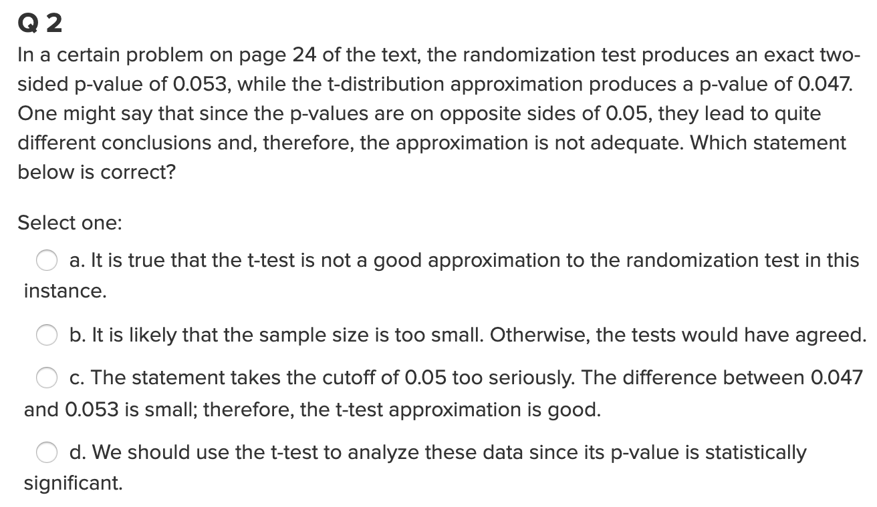
Question 2

Slide 6
End Part 1

Slide 7
Part 2

Slide 8
Question 1 (2 hours)
IBM gives each employee in the marketing department technical training
Based on further testing, it appears the traditional training method isn’t effective
Hence, a new training method is developed
Below are the test scores of 4 individuals who just finished the “New Method” and the last 3 test scores from employees trained via the “Traditional Method” course
Is there evidence to suggest that the “New Method” increases test scores?
A) Address the assumption of a t-test to answer this question.
Perform the test you feel is appropriate given the methods you have learned thus far.
As a reminder: Please clearly address this problem with slides that you will present in breakout and submit those slides to 2DS before live session (preferably 24 hours before.)
New Method | Traditional Method
37 | 23
49 | 31
55 | 46
77

Slide 9
Review the Two Examples in Order to Answer Question 2

Slide 10
Welch’s t-Test

Slide 11
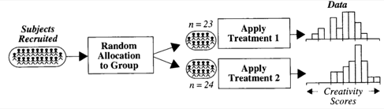


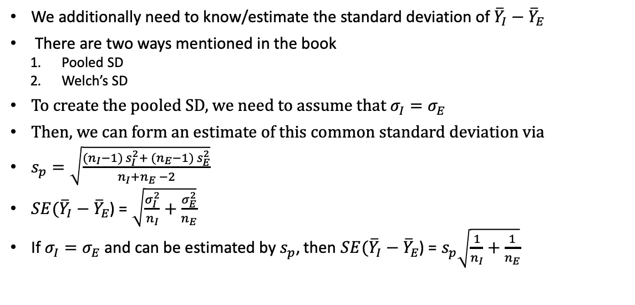


Creativity Study: Reminder
$→$ Population mean: $μ_{I}$
I
$→$ Population sd: $σ_{I}$
$→$ Population mean: $μ_{E}$
E
$→$ Population sd: $σ_{E}$
We additionally need to know/estimate the standard deviation of ${\overline{Y}}_{I}−{\overline{Y}}_{E}$
There are two ways mentioned in the book
Pooled SD
Welch’s SD
To create the pooled SD, we need to assume that $σ_{I}=σ_{E}$
Then, we can form an estimate of this common standard deviation via
$s_{p}=\sqrt{\frac{({n_{I}−1) s}_{I}^{2}+ ({n_{E}−1) s}_{E}^{2}}{n_{I}+n_{E} −2}}$
$SE({\overline{Y}}_{I}−{\overline{Y}}_{E}$) = $\sqrt{\frac{σ_{I}^{2}}{n_{I}}+\frac{σ_{E}^{2}}{n_{E}}}$
If $σ_{I}=σ_{E}$ and can be estimated by $s_{p}$, then $SE({\overline{Y}}_{I}−{\overline{Y}}_{E}$) = $s_{p}\sqrt{\frac{1}{n_{I}}+\frac{1}{n_{E}}}$
What if this assumption isn’t true?

Slide 12

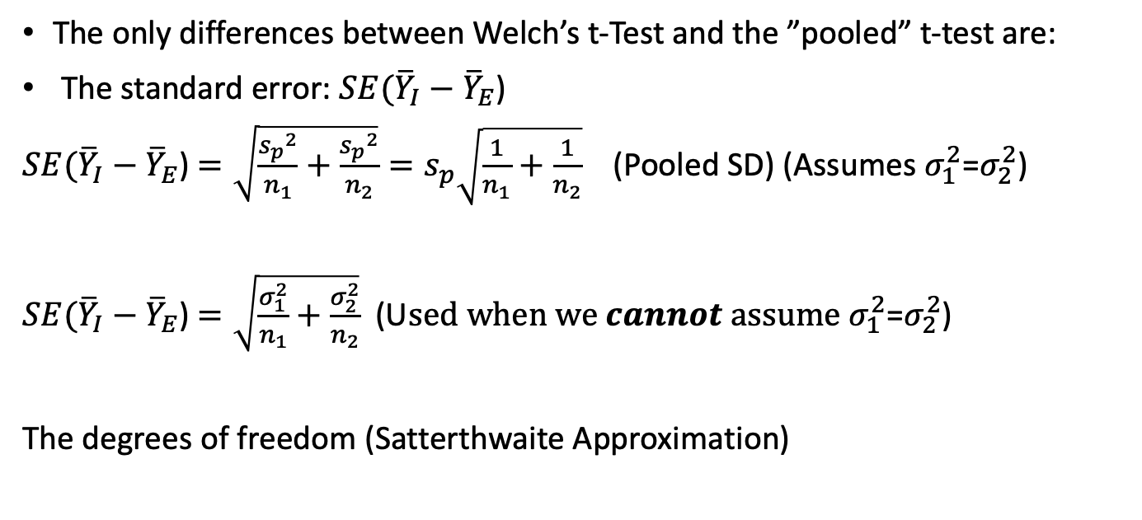
Welch’s t-Test
The only differences between Welch’s t-Test and the ”pooled” t-test are:
The standard error: $SE({\overline{Y}}_{I}−{\overline{Y}}_{E}$)
$SE({\overline{Y}}_{I}−{\overline{Y}}_{E}$) $=\sqrt{\frac{{s_{p}}^{2}}{n_{1}}+\frac{{s_{p}}^{2}}{n_{2}}}=s_{p}\sqrt{\frac{1}{n_{1}}+\frac{1}{n_{2}}}$ (Pooled SD) (Assumes $σ_{1}^{2}$=$σ_{2}^{2}$)
$SE({\overline{Y}}_{I}−{\overline{Y}}_{E}$) $=\sqrt{\frac{σ_{1}^{2}}{n_{1}}+\frac{σ_{2}^{2}}{n_{2}}}$ (U$sed when we cannot assume σ_{1}^{2}$=$σ_{2}^{2}$)
The degrees of freedom (Satterthwaite Approximation)

Slide 13
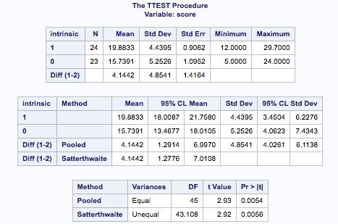

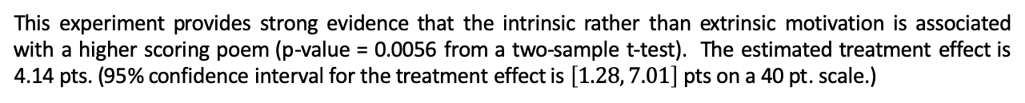
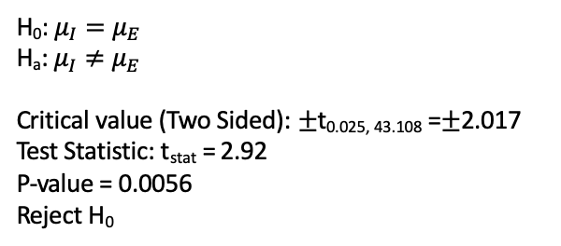
Testing Hypothesis: Welch’s t-Tools
H₀: $μ_{I}=μ_{E}$
H_{a}: $μ_{I}≠μ_{E}$
Critical value (Two Sided): $±$t_{0.025, 43.108} =$±$2.017
Test Statistic: t_{stat} = 2.92
P-value = 0.0056
Reject H₀
This experiment provides strong evidence that the intrinsic rather than extrinsic motivation is associated with a higher scoring poem (p-value = 0.0056 from a two-sample t-test). The estimated treatment effect is 4.14 pts. (95% confidence interval for the treatment effect is $\left[1.28, 7.01\right]$ pts on a 40 pt. scale.)
In R: t.test(Score~Treatment_S, data = Creativity, var.equal=FALSE)

Slide 14
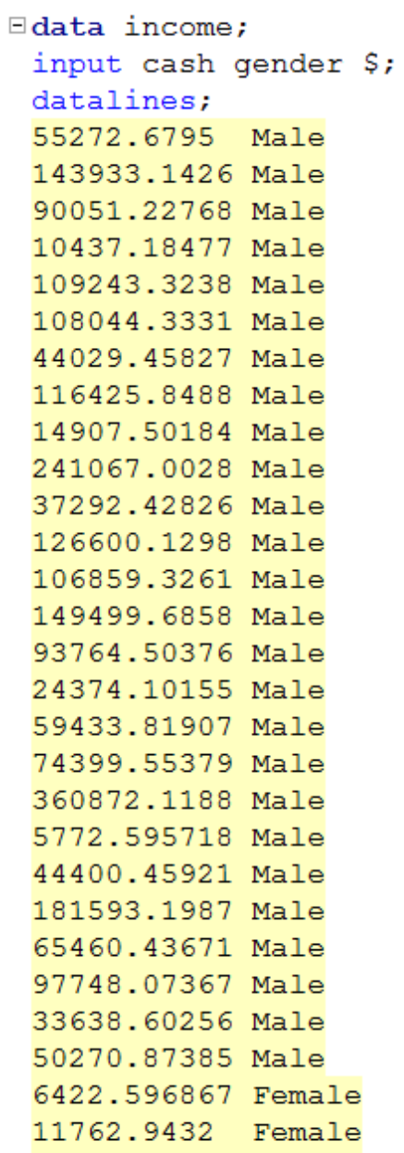
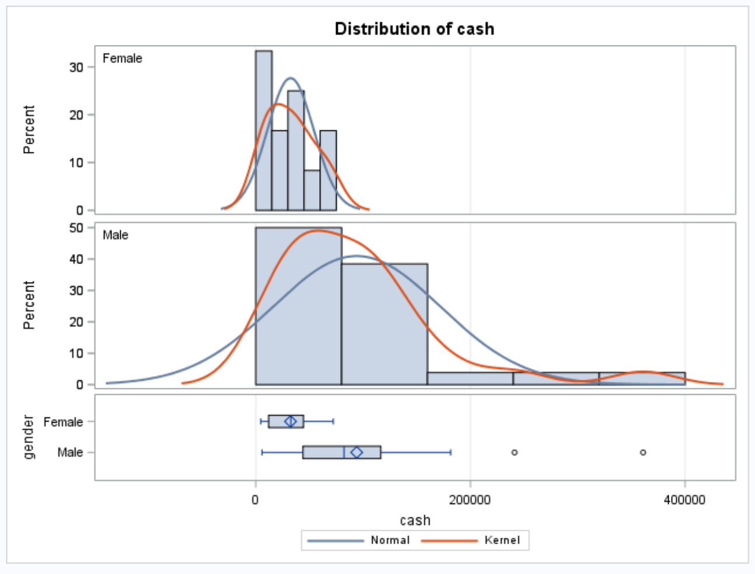
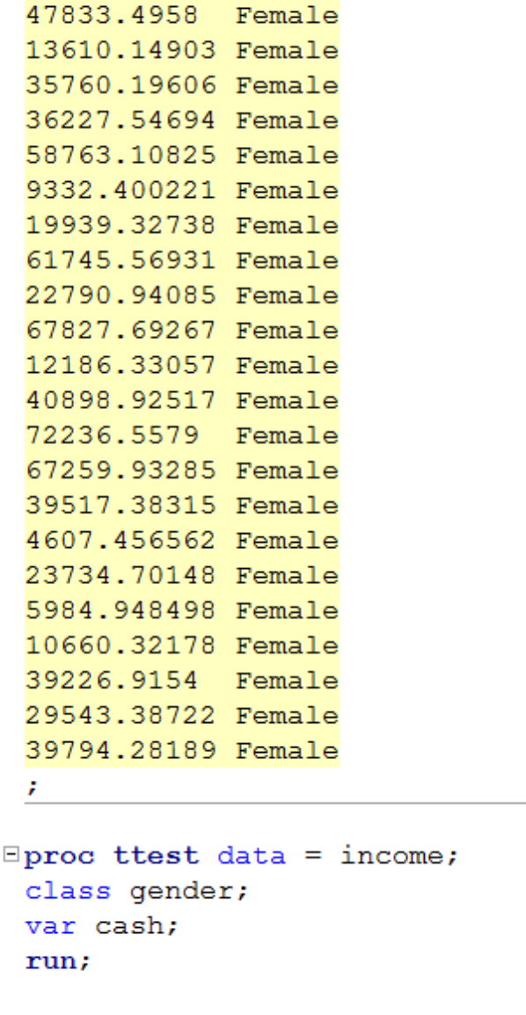
Gender Income Discrimination

Slide 15
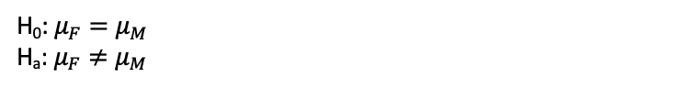
Gender Income Discrimination
H₀: $μ_{F}=μ_{M}$
H_{a}: $μ_{F}≠μ_{M}$
Strong evidence against normality, but CTL applies.
Strong evidence against equal standard deviations and different sample sizes. (They are close but the standard deviations appear to be so different that this may make a real difference.)
We will assume independence.
Student’s t-test not a good idea here.

Slide 16
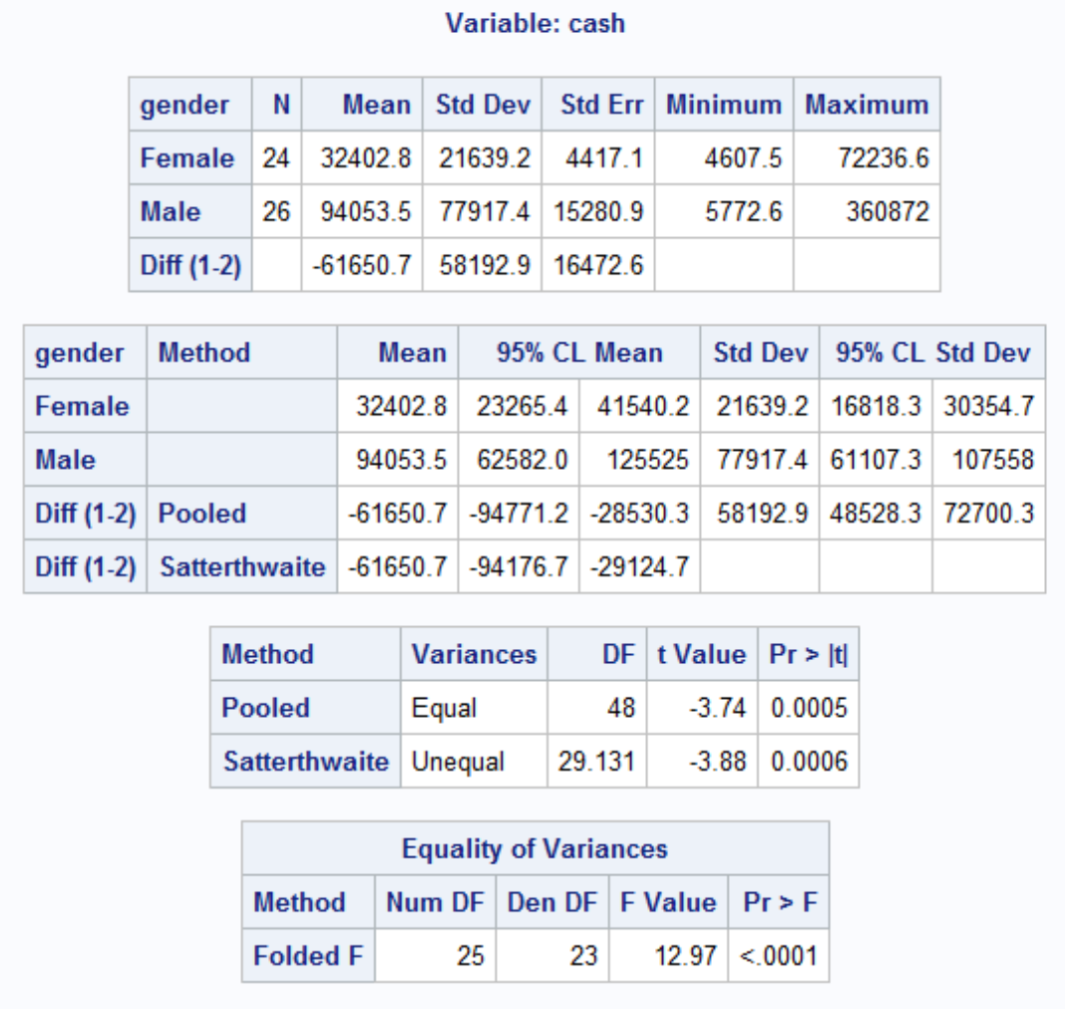
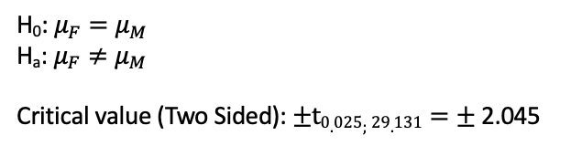
Gender Income Discrimination!
H₀: $μ_{F}=μ_{M}$
H_{a}: $μ_{F}≠μ_{M}$
Critical value (Two Sided): $±t0.025;29.131=±$2.045
Test Statistic: t_{stat} = -3.88
P-value = .0006
Reject H₀
Conclusion: There is strong evidence to suggest that the mean income of the female group is different from the mean income of the male group (p-value = 0.0006). A 95% confidence interval for this difference is ($29,124, $94,176) in favor of the males.
That is quite a difference!

Slide 17
Question 2 (2 hours)
Conduct a Welch’s two-sample t-test on the Education Data from HW 3 (untransformed). Perform a complete analysis using SAS to test the claim that the mean income of college educated people (16 years of education) is greater than the mean of those with a high school education only (12 years of education).
State the problem, address the assumptions. Be sure to support with your knowledge of theory (CLT) as well as with histograms, box plots, q-q plots, etc.
Show all 6 steps, including a thoughtful, thorough, yet non-technical conclusion. Include a confidence interval.
Include a scope of inference at the end. (You may copy and paste this from a previous HW if you like.)
Verify the Welch’s t statistic and p-value with R (using R function t.test). Simply cut and paste your R code and output. You may use: http://rcompanion.org/rcompanion/d_02.html for reference.
Would you prefer to run the log transformed analysis you ran in HW3, or do you feel this analysis is more appropriate? Why or Why not? (Make mention of the assumptions as well as the parameters that each test provides inference on. As you know, they are different.)

Slide 18
End Part 2

Slide 19
End Unit 4 For Live Session Assignment

